Slide 1
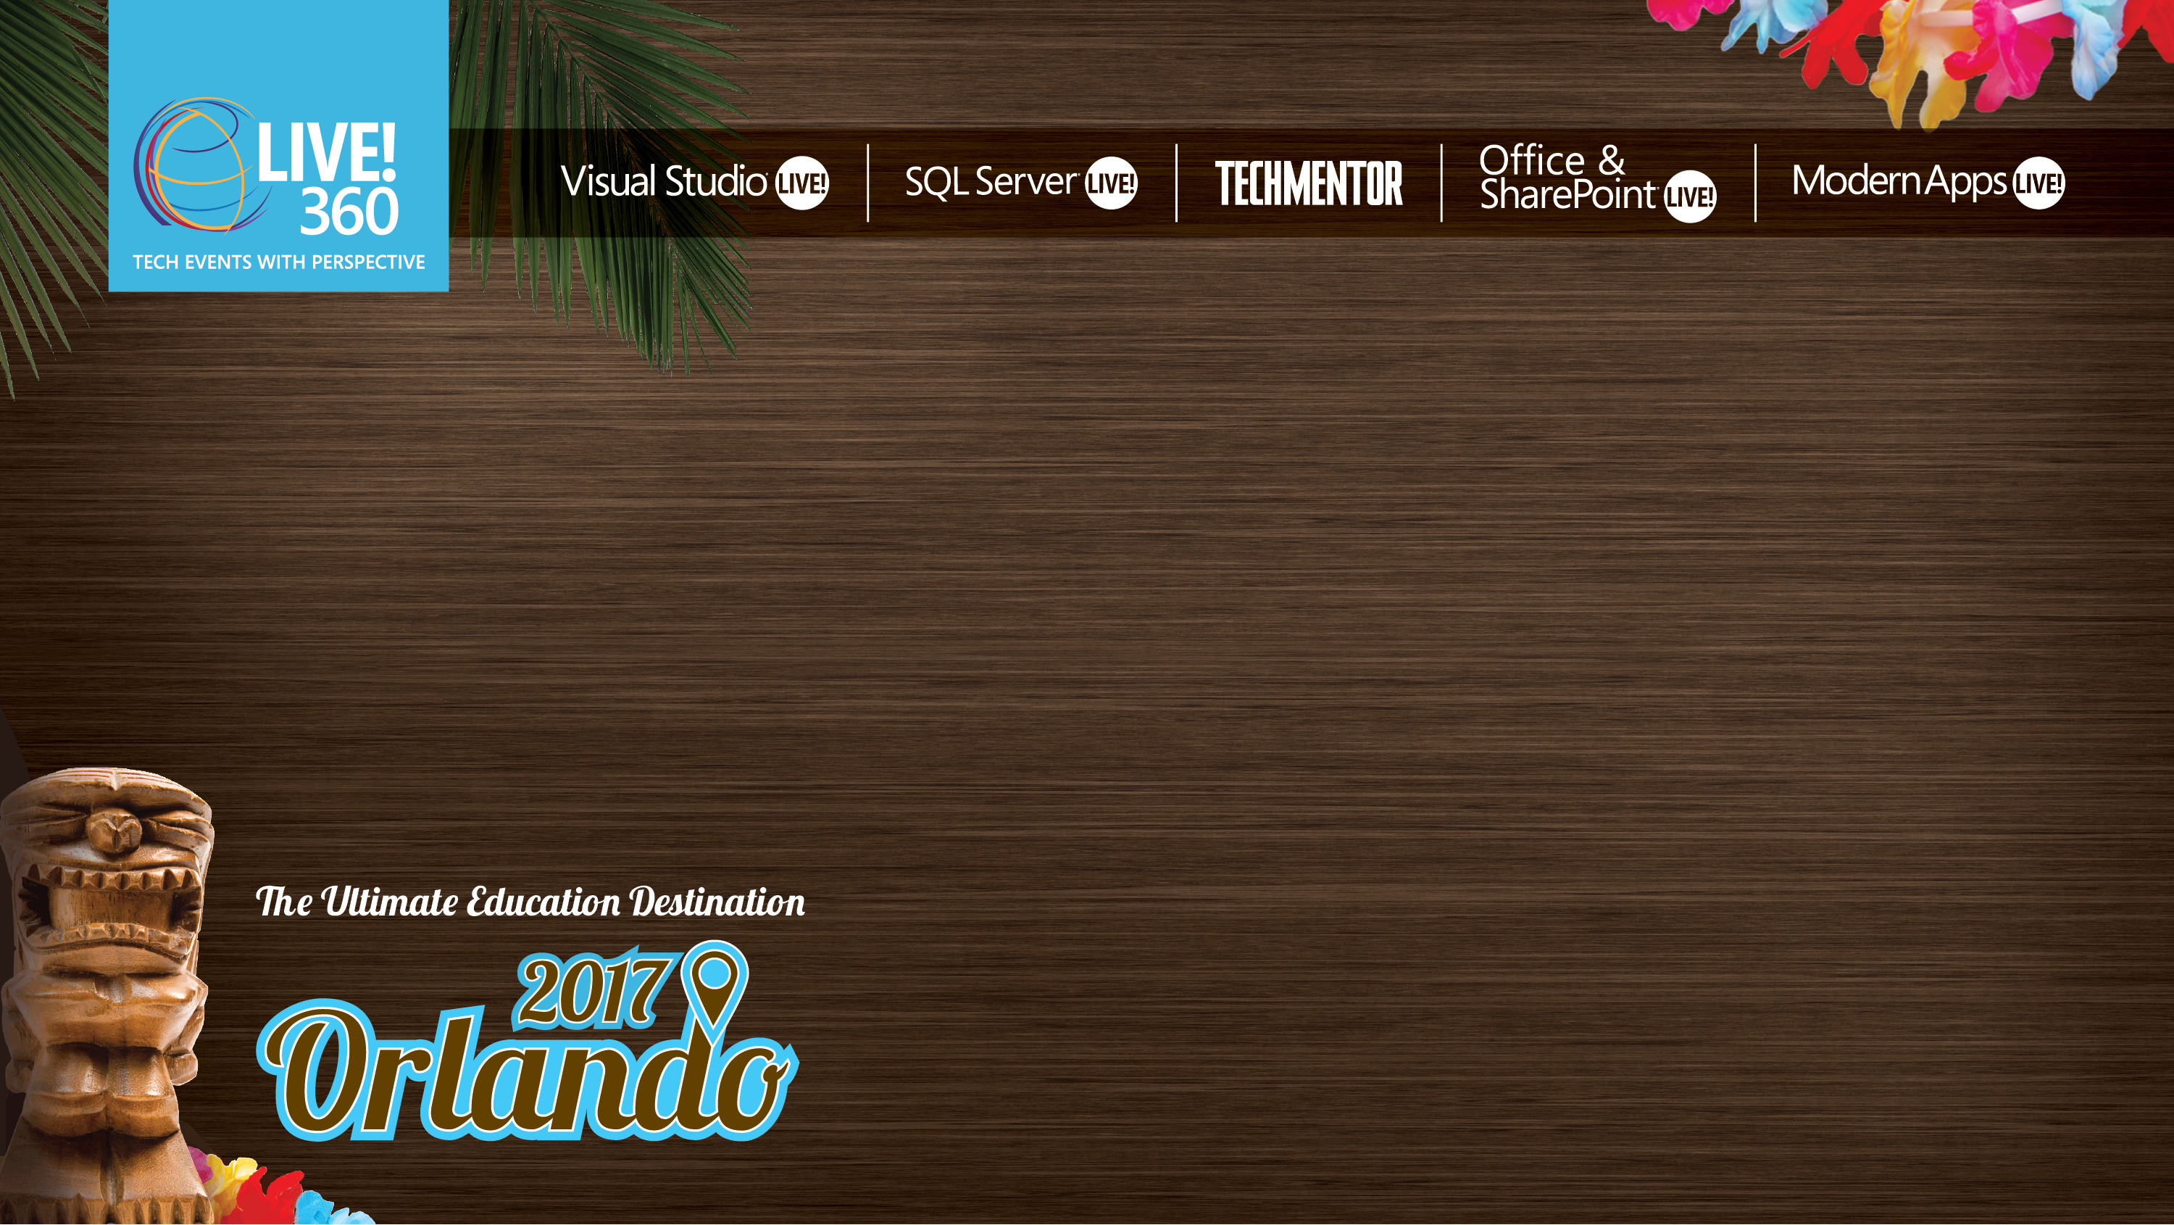
Modern App Deep Dive
Universal Windows Platform
Brent Edwards
Principal Lead Consultant
Magenic
Level: Intermediate

Slide 2
Brent Edwards
BrentE@magenic.com
@brentledwards
http://www.brentedwards.net
https://github.com/brentedwards

Slide 3
Source Code
Mobile Tasks
https://github.com/brentedwards/MobileTasks
MyVote
https://github.com/magenic/myvote

Slide 4
What is UWP?

Slide 5
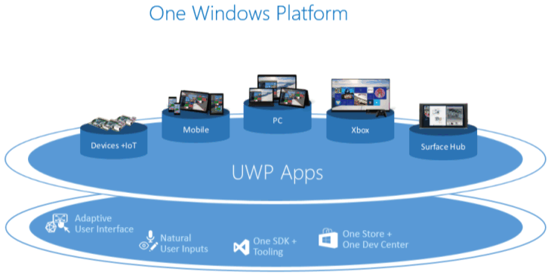
Universal Windows Platform
https://msdn.microsoft.com/en-us/library/windows/apps/dn894631.aspx

Slide 6
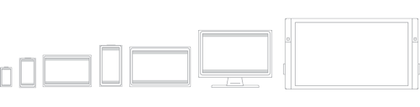
What is UWP?
Build Windows Apps with C# and XAML
https://msdn.microsoft.com/en-us/library/windows/apps/dn894631.aspx

Slide 7
UWP Device Families
Windows 8.1/Windows Phone 8.1 target an OS
Windows 10 provides common app platform
Targets Device Families
One package for all (AppX)
One store for all devices

Slide 8
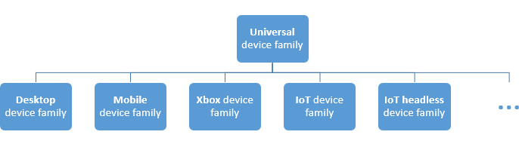
UWP Device Families
https://msdn.microsoft.com/en-us/library/windows/apps/dn894631.aspx

Slide 9
History
C#
Evolved from .NET to WinRT to UWP
XAML
Started with WPF
Evolved with Silverlight, WP, Windows Store

Slide 10
Dev Machine Requirements
Universal Windows
Windows 10 PC
Visual Studio 2015

Slide 11
Testing
Windows Simulator
Dev Machine
Physical Devices

Slide 12
UWP Foundation

Slide 13
Universal Foundation
Layouts
Controls
Styles

Slide 14
Example Controls

Slide 15

RelativePanel
https://msdn.microsoft.com/library/windows/apps/windows.ui.xaml.controls.relativepanel.aspx

Slide 16
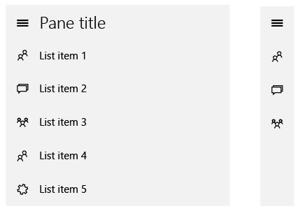
SplitView
https://msdn.microsoft.com/en-us/library/windows/apps/dn997787.aspx

Slide 17
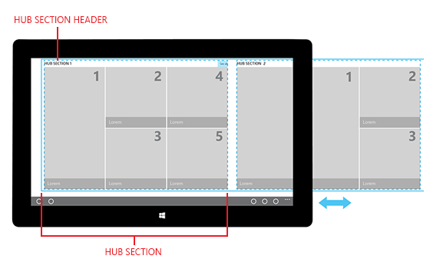
Hub
https://msdn.microsoft.com/en-us/library/windows/apps/dn449149.aspx

Slide 18
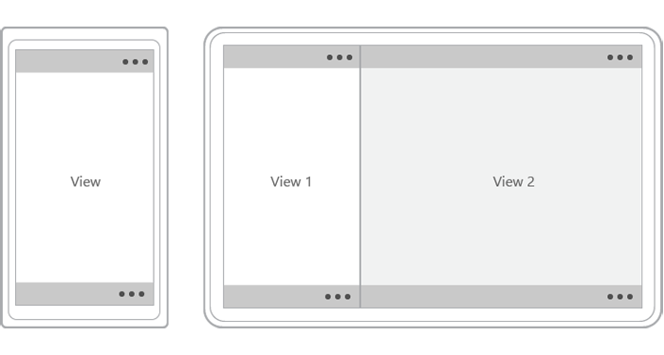
CommandBar
https://msdn.microsoft.com/en-us/library/windows/apps/hh465302.aspx

Slide 19
UI Patterns

Slide 20
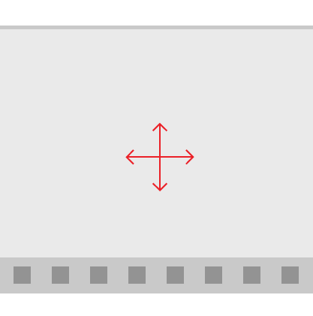
Active Canvas
https://msdn.microsoft.com/en-us/library/windows/apps/dn997761.aspx
Notes:
Content area (above) and Command area (below)

Slide 21
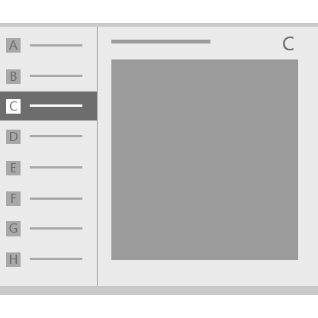
Master/Detail
https://msdn.microsoft.com/en-us/library/windows/apps/dn997765.aspx

Slide 22

Nav Pane
https://msdn.microsoft.com/en-us/library/windows/apps/dn997766.aspx

Slide 23

Tabs and Pivots
https://msdn.microsoft.com/en-us/library/windows/apps/dn997788.aspx

Slide 24
Multiple Device Families
Great support for responsive layouts
Lean on
GridView
RelativePanel
StackPanel
Visual States
AdaptiveTrigger

Slide 25
XAML Designer
[DEMO]

Slide 26
MVVM
Model-View-ViewModel

Slide 27
MVVM
View
Presentation
View Model
Presentation Logic
Model
Business Logic

Slide 28
Why is MVVM Cool?
Separates Presentation from Functionality
Promotes Testability
Works great with Data Binding
Easy collaboration with Designers
Makes it easy to change out the View layer!

Slide 29
Data Binding

Slide 30
Data Binding
What is it?
Ability to bind an element in a view to a property on a view model (or other object)
Binding Modes
OneTime
OneWay
TwoWay

Slide 31
Data Binding
2 Syntax Flavors in UWP
Old School
{Binding Stuff}
Uses reflection to find Stuff property on current DataContext
New School
{x:Bind Stuff}
Compiles the binding using the context of the Page or UserControl

Slide 32
Data Binding
Lots of power
Can bind to single properties or collections of objects
Can provide DataTemplates for collections that further leverage data binding

Slide 33
Implementing Data Binding
View Models implement INotifyPropertyChanged
Raise PropertyChanged events every time data changes or binding should be refreshed
MVVM frameworks can help with this

Slide 34
Data Binding
[DEMO]

Slide 35
Data Templates

Slide 36
Data Templates
Define presentation of your data
Can give your business objects a “look”
Can leverage data binding
Templates can be
Local to control
Local to Page/UserControl in Resource Dictionary
In Global Resource Dictionary

Slide 37
Data Templates
[DEMO]

Slide 38
Style

Slide 39
Style
Change look-and-feel of controls
Can inherit from existing styles
Two types
Implicit
By Type
Explicit
By Key

Slide 40
Visual States
Another way to change look-and-feel
States can be changed by
Code
Triggers
StateTrigger
AdaptiveTrigger

Slide 41
Style
[DEMO]

Slide 42
Value Converters

Slide 43
Value Converters
Converts data value to format required by UI
How to use it
Implement IValueConverter
Add to resources with a Key
Use it

Slide 44
Value Converters
[DEMO]

Slide 45
Navigation

Slide 46
Navigation
Much simpler with Universal Apps!
Approach is now unified
View-driven with 1 optional parameter
Parameter can be anything
2 Problems
Logic for navigation is generally in ViewModel
ViewModels have to know about Views?!?!
Complex parameter types cause weird problems

Slide 47
Navigation
Solution
Use an MVVM framework
Build simple ViewModel-driven navigation
Notes:
MyVoteApp to wire up custom MvxAppStart

Slide 48
Navigation
[DEMO]

Slide 49
Azure mobile services

Slide 50
Azure Mobile Apps
Primary Features
Authentication
Push Notifications

Slide 51
Authentication
oAuth done easy
4 Auth Options
Twitter
Facebook
Microsoft
Google
Biggest Drawback
Users have to remember which option they chose

Slide 52
Authentication
Things to consider
Is your app open to anyone?
Social Networks
Does your app need domain authentication?
Active Directory

Slide 53
Push Notifications
Deliver info to your users through notifications
Tile
Badge
Toast
Things to consider
How can your Tile be more Live?
What info to show in Toasts?

Slide 54
Azure Mobile APPS
[DEMO]

Slide 55
Azure blob storage

Slide 56
Azure Blob Storage
A Couple of Options
Nuget Package
Windows Azure Storage
REST API

Slide 57
Windows Azure Storage Library
Nuget Package
Gives access to containers and blobs
Can use credentials directly
Or, better yet…

Slide 58
Storage Access Security (SAS)
What is it?
Temporary key
Has built-in expiration
SAS keeps credentials out of client
Recommend generating on server

Slide 59
REST API
Provides all Blob Storage functionality
Create containers
Upload blobs
Can use credentials directly
Better yet, use SAS

Slide 60
Azure blob storage
[DEMO]

Slide 61
Application lifecycle

Slide 62
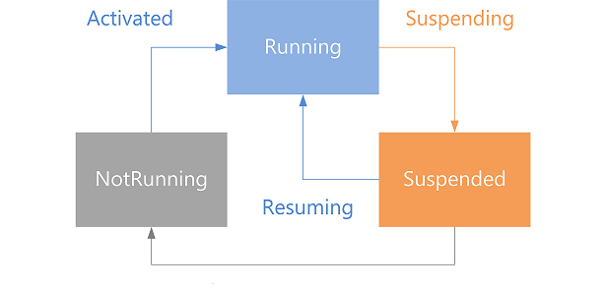
Application Lifecycle
https://msdn.microsoft.com/en-us/windows/uwp/launch-resume/app-lifecycle

Slide 63
Application Lifecycle
Deployment
Launch
Activation
Suspension
Resuming
Closing
Removal

Slide 64
Unit testing

Slide 65
Unit Testing
Create Universal test project
Can run tests locally within Visual Studio

Slide 66
Continuous INtegration

Slide 67
Continuous Integration
Build server needs UWP dev tools installed

Slide 68
deployment

Slide 69
Deployment
Can be done with Visual Studio
Don’t forget to add all assets for icons, etc.
Create App Packages
Choose App Name
Choose Configurations
Test with local Windows App Certification Kit

Slide 70
Thoughts on uwp

Slide 71
Strengths
Working with Visual Studio and C#
Testing is very easy
Cover all Windows device families in one shot
Now has support for .NET Standard 2.0

Slide 72
Weaknesses
Windows only

Slide 73
Conclusion
Best choice if building for Windows only
Visual Studio is second to none
Makes the experience very smooth

Slide 74
Questions?

